Slide 1
Recurrent Neural Networks (RNNs)
COMP 4230
David J Stucki
Fall 2021

Slide 2
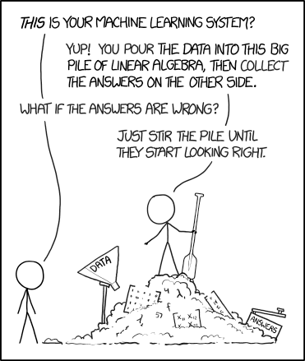
Alerts
Read Moroney Chapter 7
Read Larson Chapter 12
The pile gets soaked with data and starts to get mushy over time, so it's technically recurrent.
https://xkcd.com/1838/

Slide 3
The Problem
“Time underlies many interesting human behaviors. Thus, the question of how to represent time in connectionist models is very important.” —Jeffrey L. Elman (Finding Structure in Time)—
In Natural Language Processing, words appear in context. This context has a significant impact on meaning, sentiment, etc.
The trucker was driving the bananas.
The trucker was driving me bananas.
I ate mashed potatoes with Mary.
I ate mashed potatoes with gravy.
I ate mashed potatoes with a fork.
In matters natural word languages order!!
Word order matters in natural languages!!

Slide 4
The solution?
“...a proposal...first described by Jordan (1986) which involves the use of recurrent links in order to provide networks with a dynamic memory. In this approach, hidden unit patterns are fed back to themselves; the internal representations which develop thus reflect task demands in the context of prior internal states. ” —Jeffrey L. Elman (Finding Structure in Time)—
In a 1986 ground-breaking paper (Serial Order: A PDP Approach) Michael I. Jordan introduced the idea of using recurrent neural networks to learn sequences of actions.
In an equally ground-breaking 1990 paper (Finding Structure in Time) Jeffrey Elman created a variation of Jordan's architecture in order to develop a neural network model with short term memory
[Copies of these papers will be put on the course web site as optional reads; they're long!]

Slide 5
Jordan Networks
Basic connection scheme
Not all connections are shown
Input nodes
Hidden nodes
Output nodes
Recurrent nodes
Input →Hidden →Output
Output→Recurrent →Hidden →Output

Slide 6
Jordan Networks
Jordan was able to train this type of network to produce specific sequences of characters
For example, in this network outputs of [1,1] represent A and [0,0] represent B
An input of [0,1] will cause the network to generate the sequence AAAB, while [1,0] will produce the sequence AB

Slide 7
Elman Networks
Basic connection scheme
Not all connections are shown
Input nodes
Hidden nodes
Output nodes
Recurrent (context) nodes
Input →Hidden →Output
Hidden→Recurrent →Hidden
There is an interesting parallel...

Slide 8
Elman Networks
Elman initially trained a simple network to predict the result of XOR in a sequential input of bits
From here he went on to train networks on sequences of letters based on a grammar in order to predict sequences of vowels that would follow a consonant
Finally, he trained networks to predict word sequences in simple sentences

Slide 9
A surprising discovery
Hierarchical cluster diagram of hidden unit activation vectors in simple sentence prediction task. labels indicate the inputs which produced the hidden unit vectors: inputs were presented in context, and the hidden unit vectors averaged across multiple contexts.
The network appears to have induced linguistic parts of speech!
(see pp. 198-201)

